Slide 1
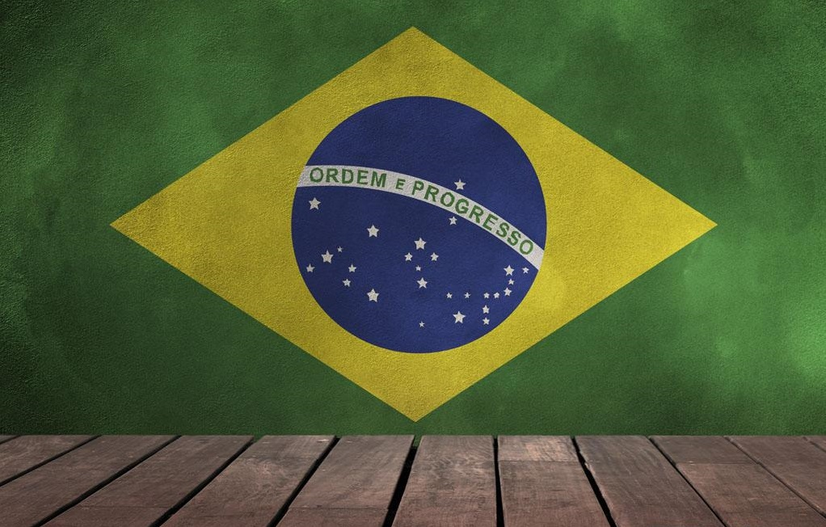

Slide 6
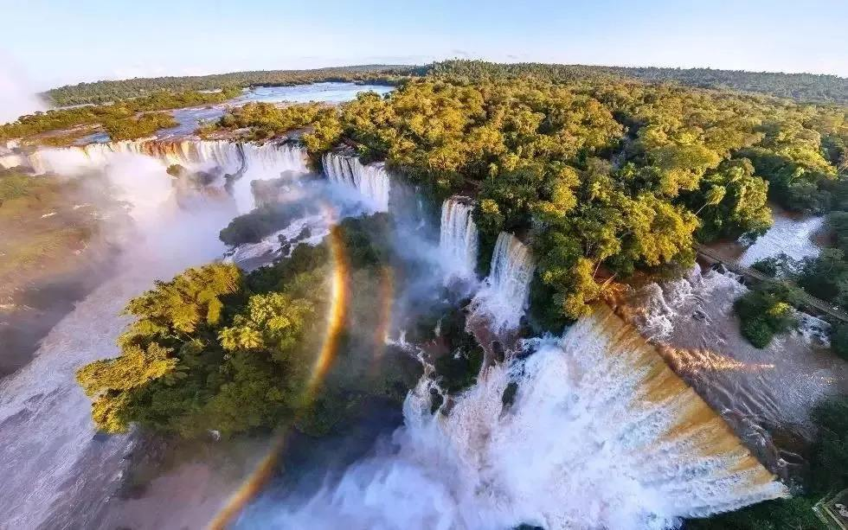
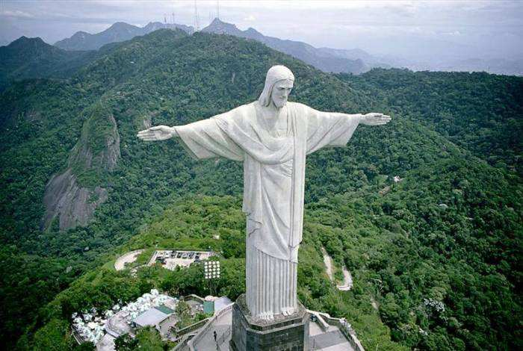

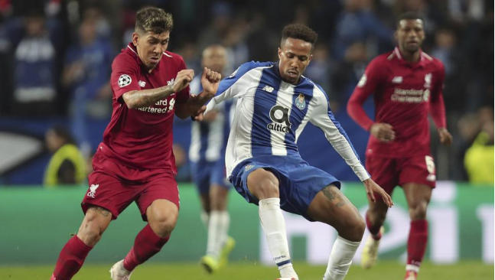
2019
Welcome to Brazil！
小组:周乐 马凯 杨鹏伟 王荣胜

Slide 7
Contents
01.Outline of Brazil
目录
02.Beautiful view of Brazil
03.Brazilian festival
04.Brazilian cuisine

Slide 8
01.Outline of Brazil
Do you know Brazil?

Slide 9
Outline of Brazil
Brazil's Climate
Brazil's Races
Geographic location
Brazil’s Language

Slide 10
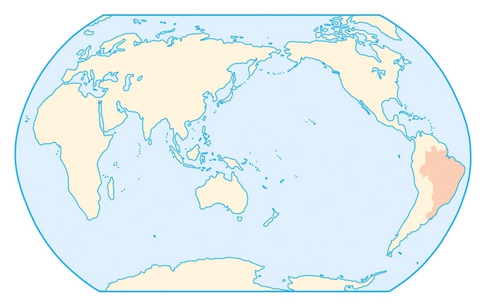
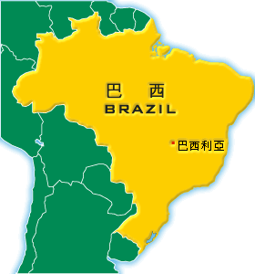
Geographic location
Brazil is the 5th largest country in the world and has the 6th largest population. It covers almost half of South America and it's borders touch 10 other countries. The only 2 countries in South America that does not share a border is Chili and Ecuador.

Slide 11
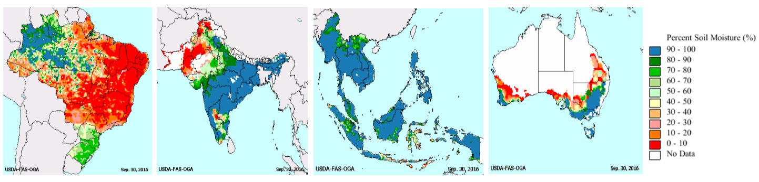
Brazil's Climate
The climate is predominantly tropical with some variation according to the region. The average annual temperature in the north is 282 C and 222 C in the south.

Slide 12
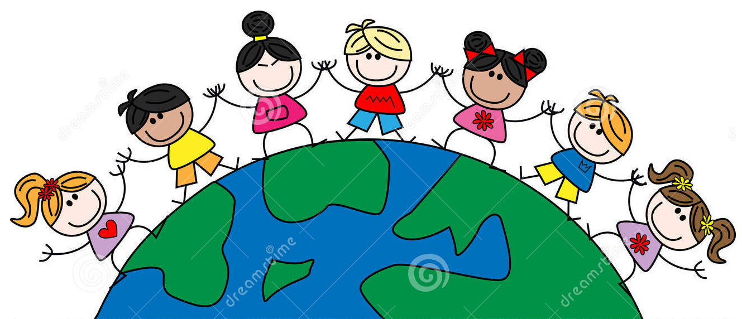
Brazil's Races
The mixture of races has made Brazil a culturally rich. This miscegenation began with the Indian, the African and the Portuguese, but soon after, immigrants from around the world began to arrive: Europeans ,Asians, Jews and Arabs.
Brazil is one of the last places on Earth where no one is a foreigner, where one can change one's destiny without losing one's identity and where each and every Brazilian has thp pntirp

Slide 13

Brazil’s Language
The official language is Portuguese; the accent and the intonation, however, are very different from what one hears in Portugal and other former Portuguese colonies. Some people say that Brazilians speak “Brazilian”， just like Americans can say they speak “American", and not English. And there are also many Brazilians who are descendants of immigrants and who speak German and Italian, especially in towns in southern Brazil.

Slide 14
02.Beautiful view of Brazil
Do you like the scenery?

Slide 15
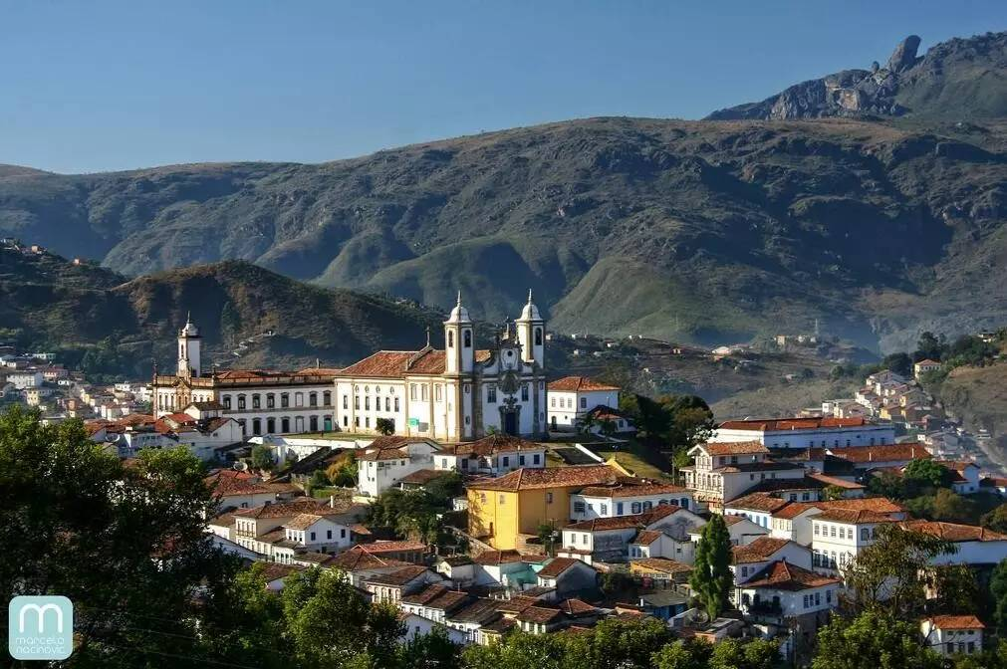
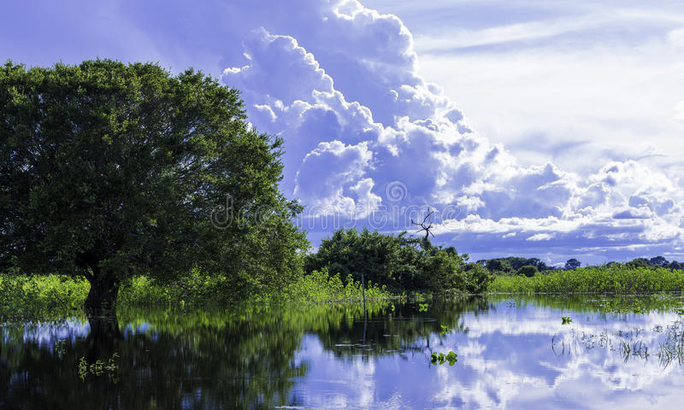
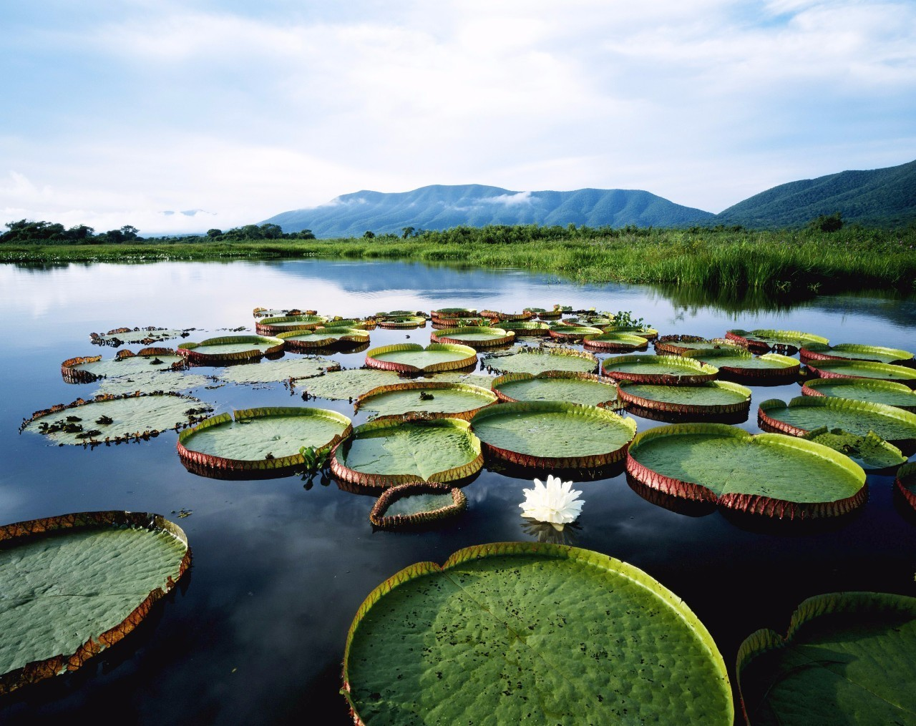
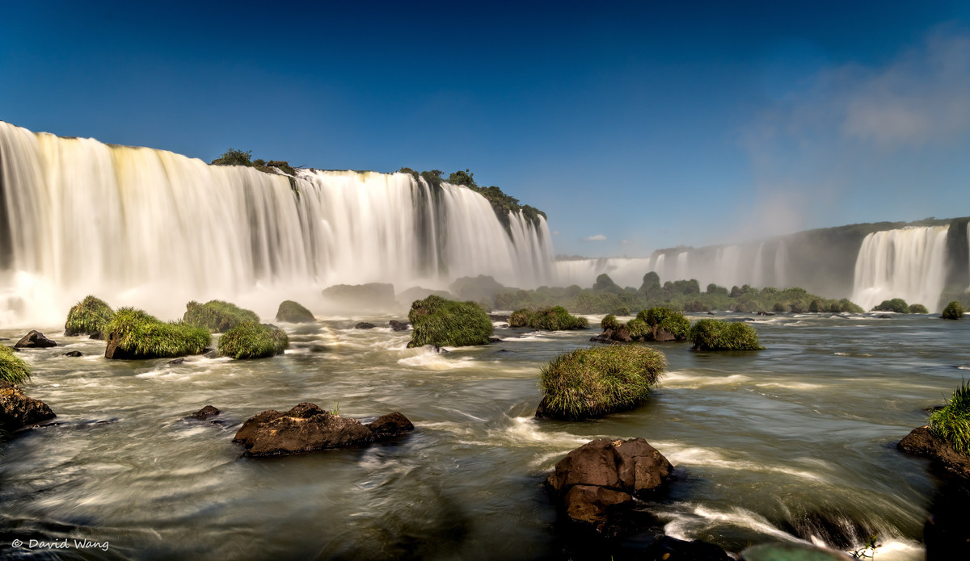
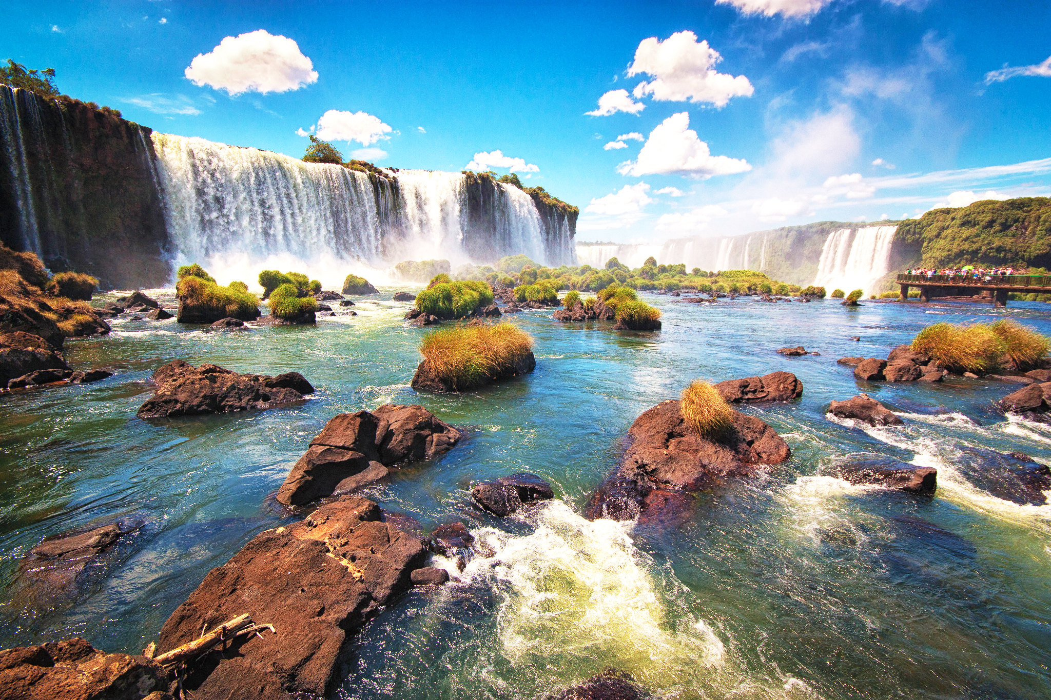
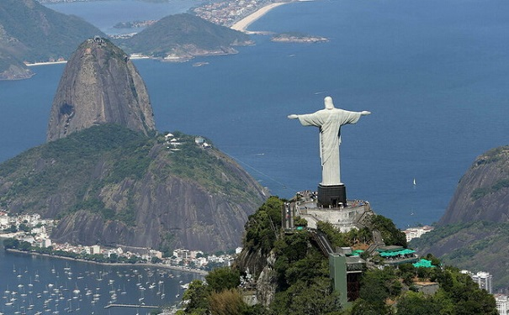
Scenery

Slide 16
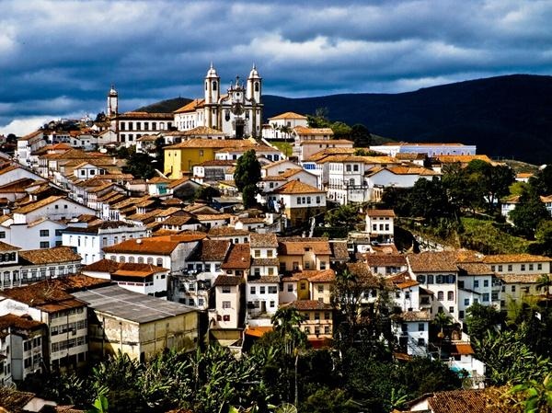
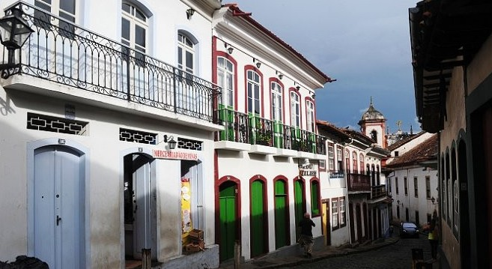
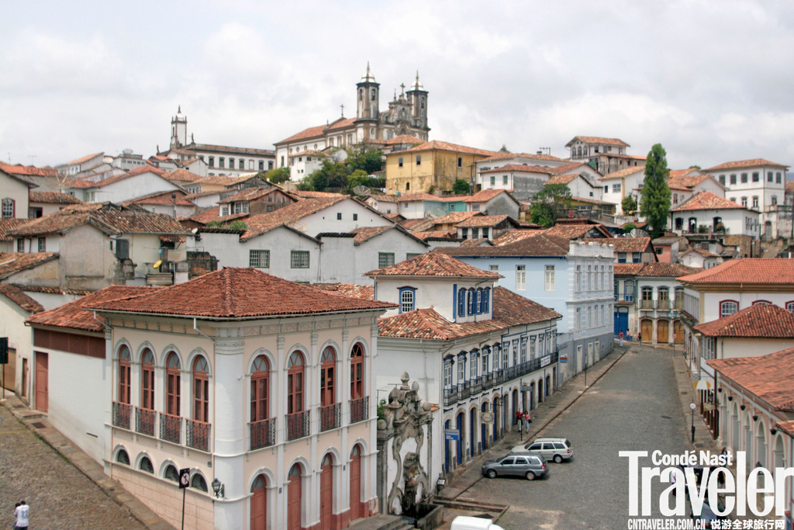
Scenery
Here is the ancient town of Ouro Pre.Most of the houses are white bungalows or two floors. Many architecture, painting, sculpture, have maintained the style of the colonial period.

Slide 17
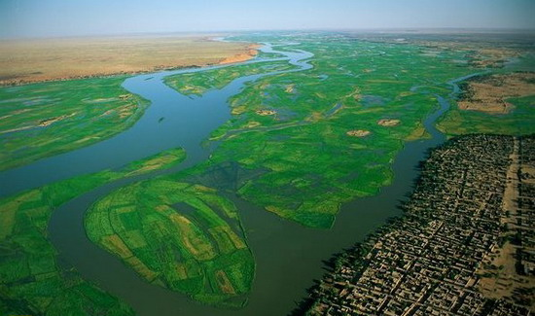
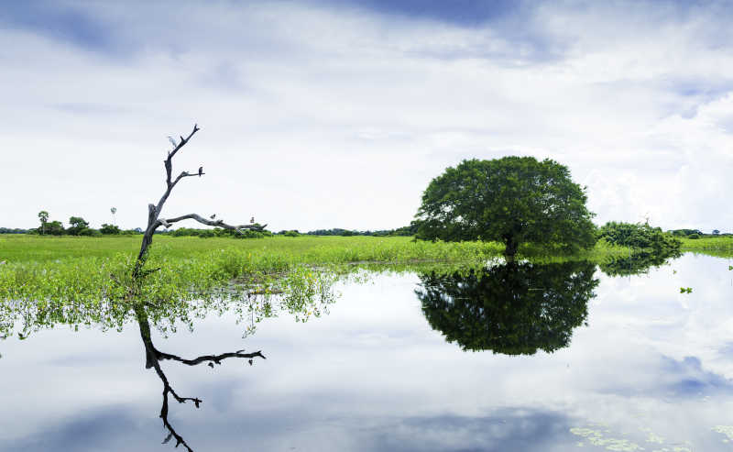
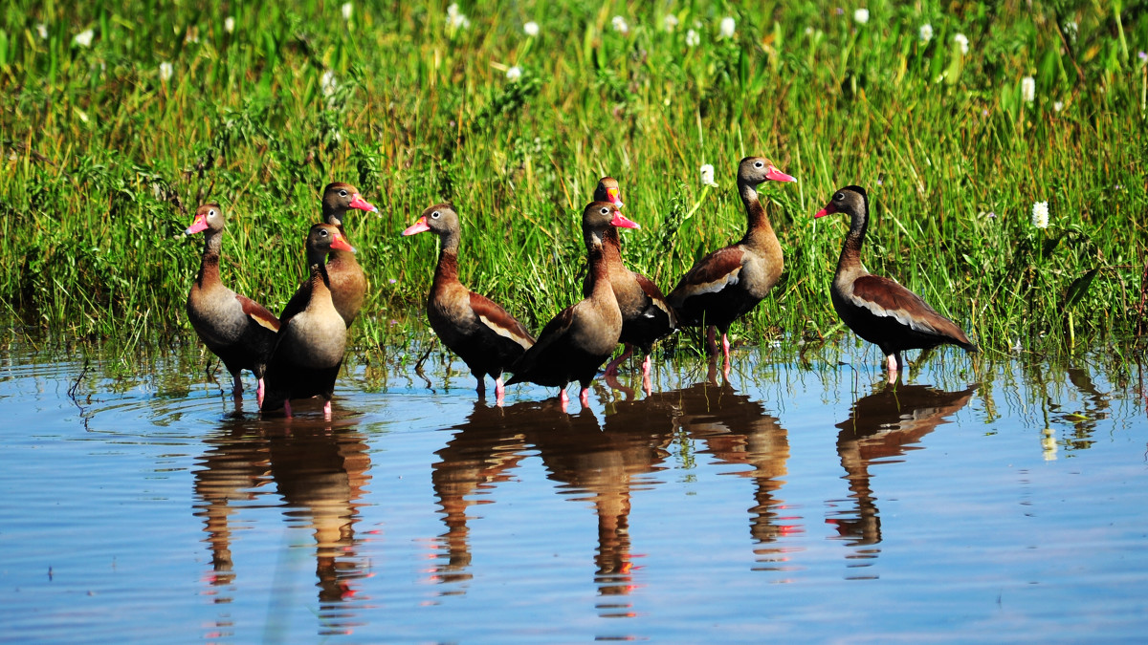
Scenery
Pantana wetland is the world's largest wetland, flat and slightly tilted, and has many twists and turns of the river,Everything here is full of vitality, and all kinds of flora and fauna are all over the land. It is a natural habitat.

Slide 18
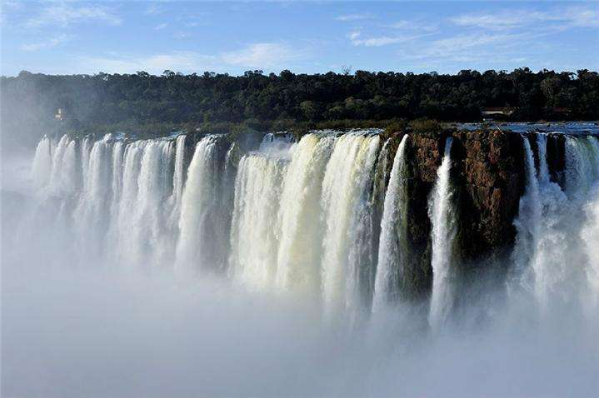
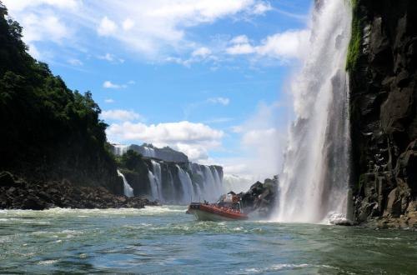
Scenery
The Iguazu Falls is the widest waterfall in the world. It is located on the border of the Iguazu River and the Parana River on the border between Argentina and Brazil. It is a horseshoe-shaped waterfall with an average drop of 75 meters.
In 1984, it was listed as a World Natural Heritage by UNESCO.

Slide 19
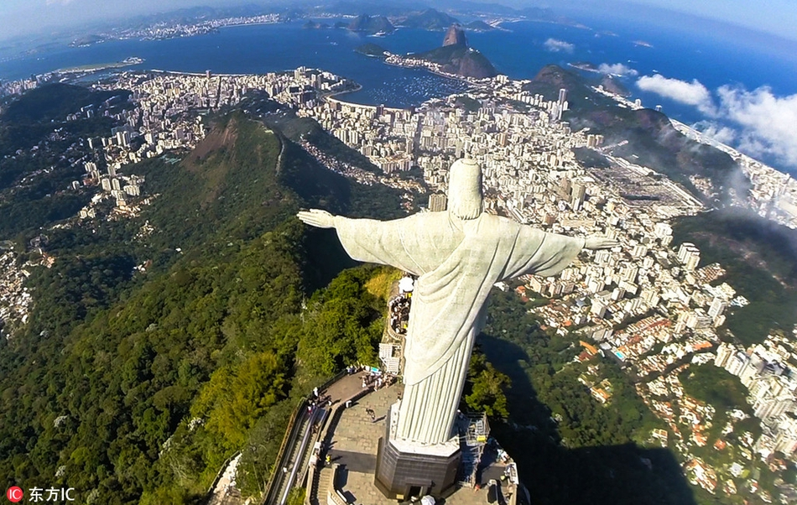
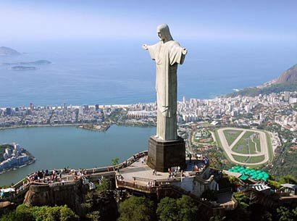
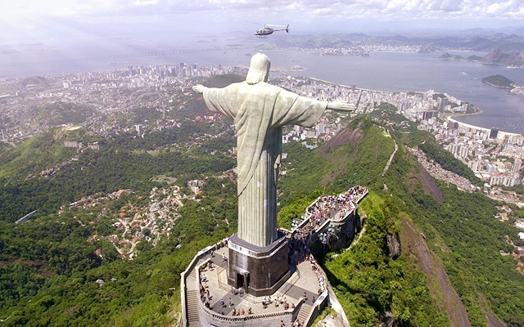
Scenery
Founded in 1931, Christ is 38 meters high and stands on the top of Corcovado, 710 meters high in the Rio de Janeiro National Forest Park. It overlooks the whole city of Rio de Janeiro. He welcomes tourists from all over the world with open arms. It is the Brazilian people. A symbol of enthusiasm and broad mind.

Slide 20
03.Brazilian festival
Do you like carnival?

Slide 21
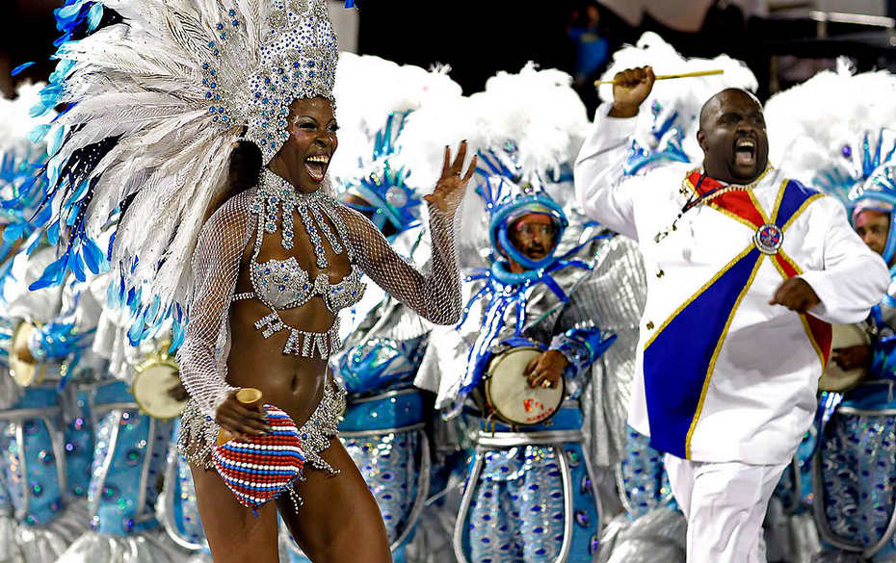
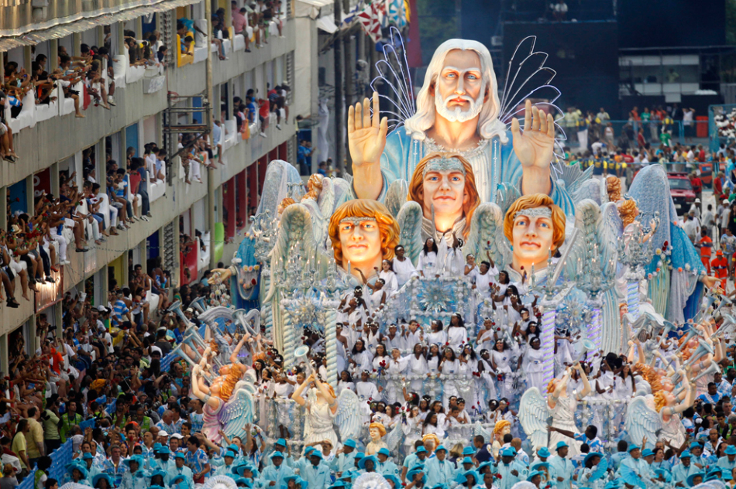
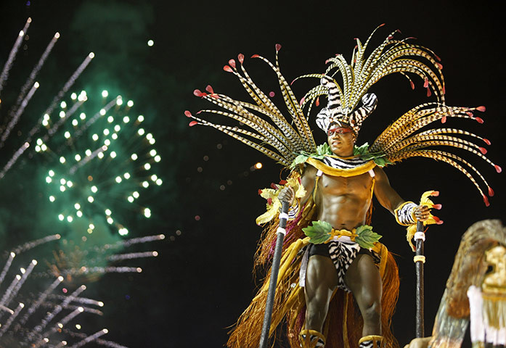
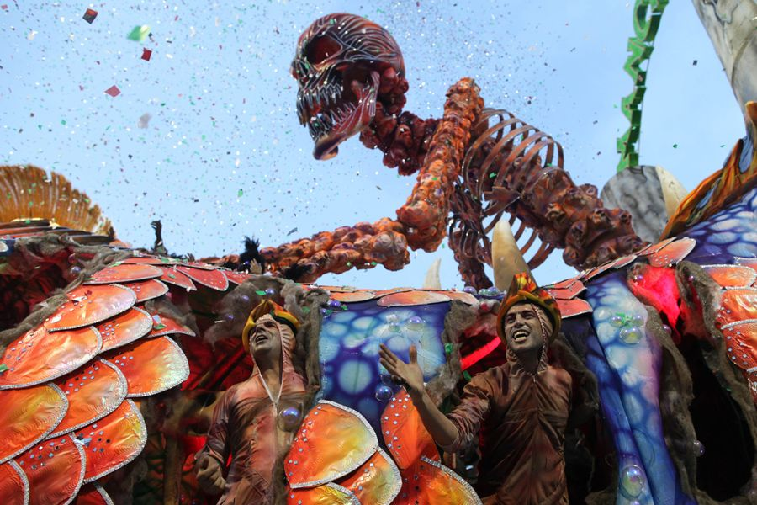
Festival

Slide 22
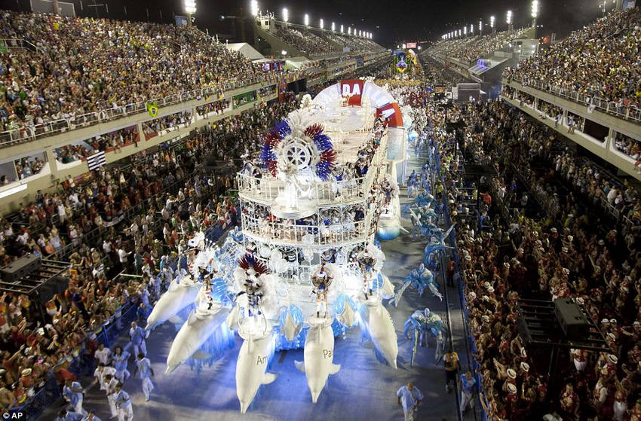
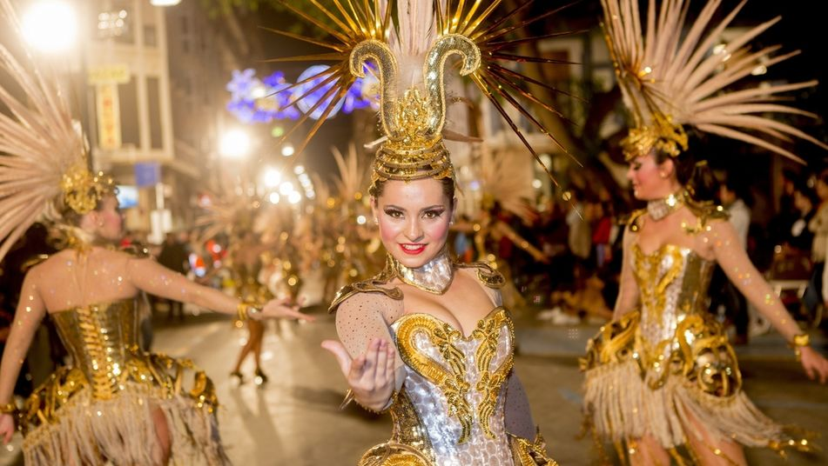
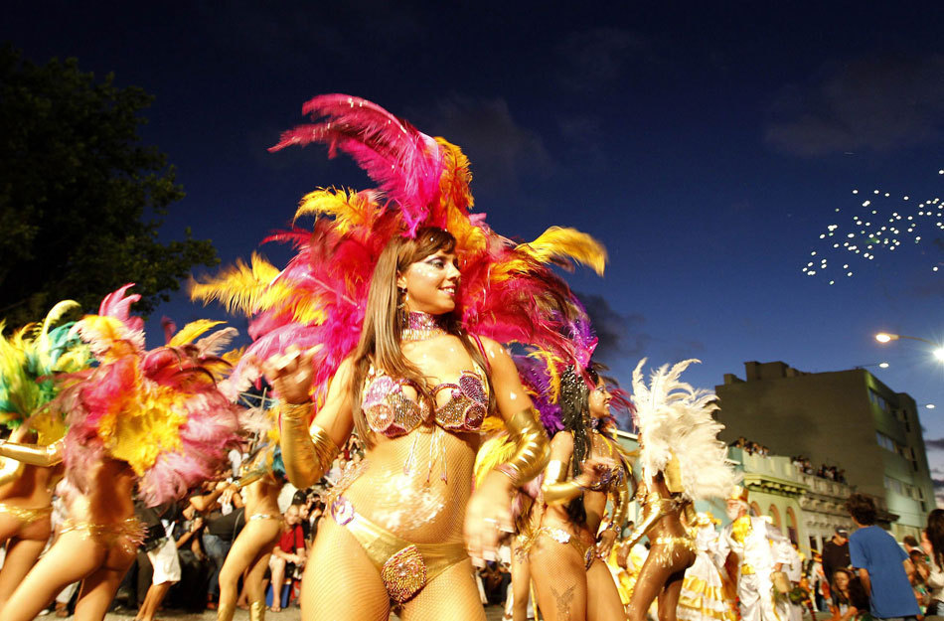
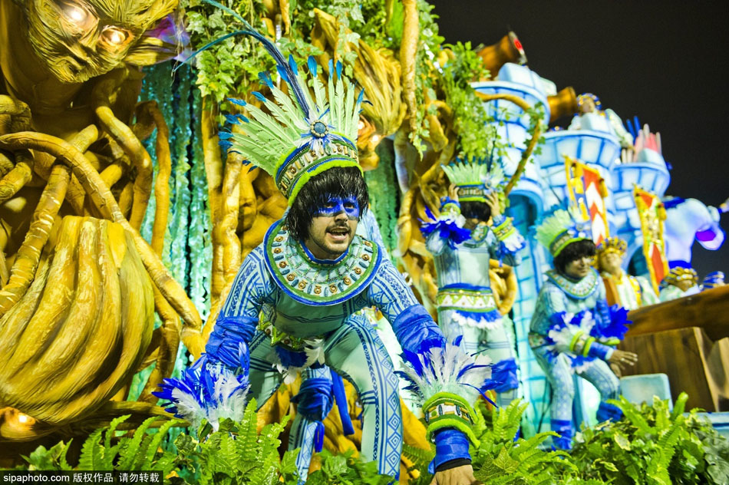
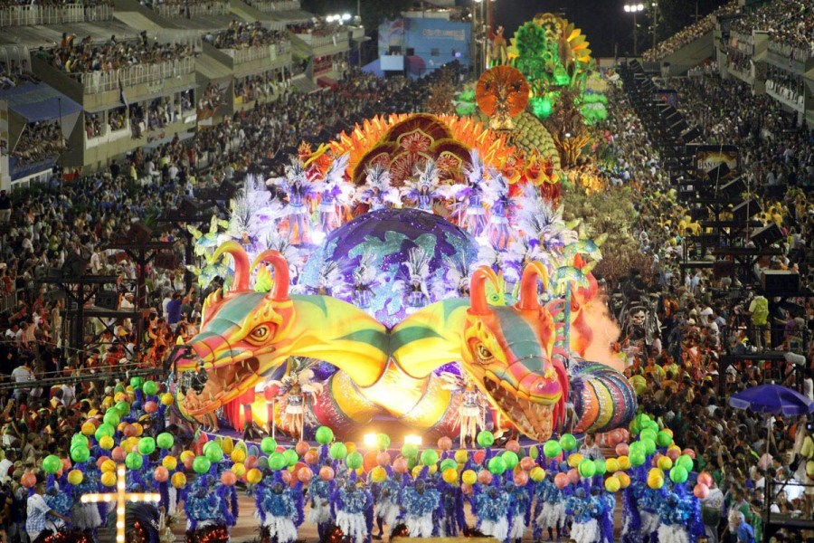
Festival
Mardi gras is a Christian festival of feasting and revelry before lent.
Originally it was extended from the main festival to the day before,but now it is usually limited to the days before.Prevalent in Europe and the United
States.

Slide 23
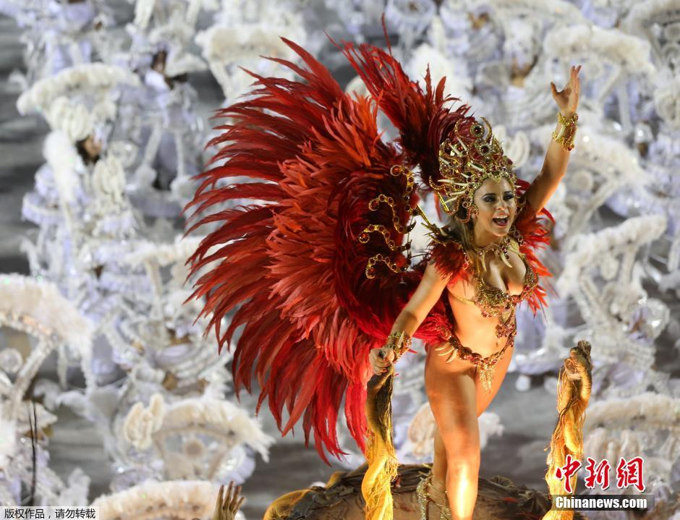
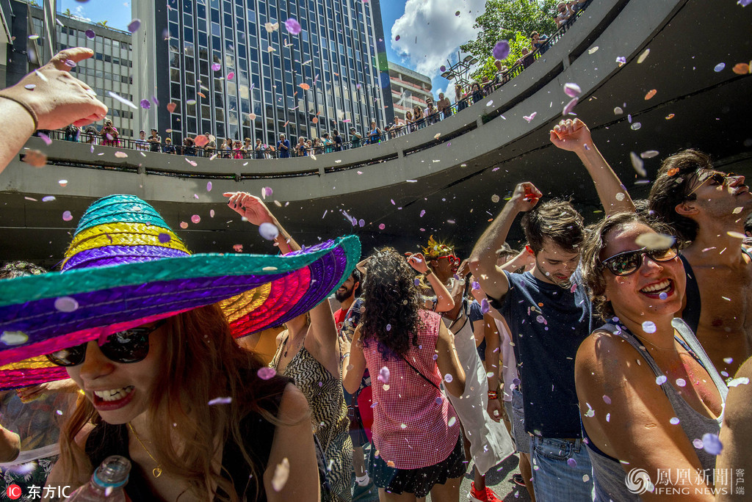
Festival
Many countries have a traditional carnival festival.Masquerade,floats,masks,
and feasts are the main features of carnival.Although these festivals are
held at different times ,most are held in February and march.
The Brazilian carnival is called the biggest carnival in the world.In Brazil's
carnival,everyone is not willing to express themselves,but to help others
Some men want to be feminine;And some normally introverted women dance
feverishly,trying to imitate the agility and power of others.Orgy often
appears "transvestite",this is the product of history.Brazil's carnival
craze for femininity can be said to be unique in the world.In Brazil's
carnival,Rio DE janeiro carnival is the world's most famous,the most
fascinating .

Slide 24
04.Brazilian cuisine
Do you like to eat food?

Slide 25
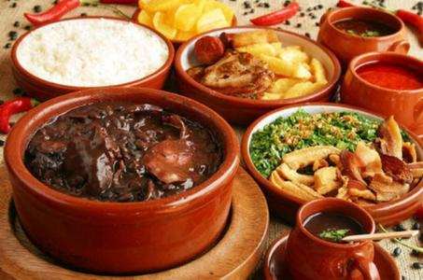
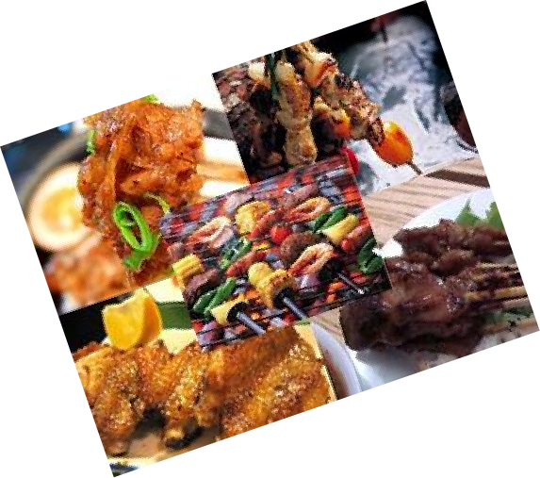
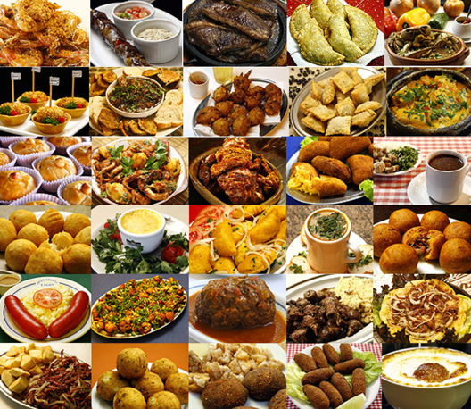
Food
Here are eight must-try Brazilian culinary treats you can eat when traveling to Brazil.Such as...

Slide 26
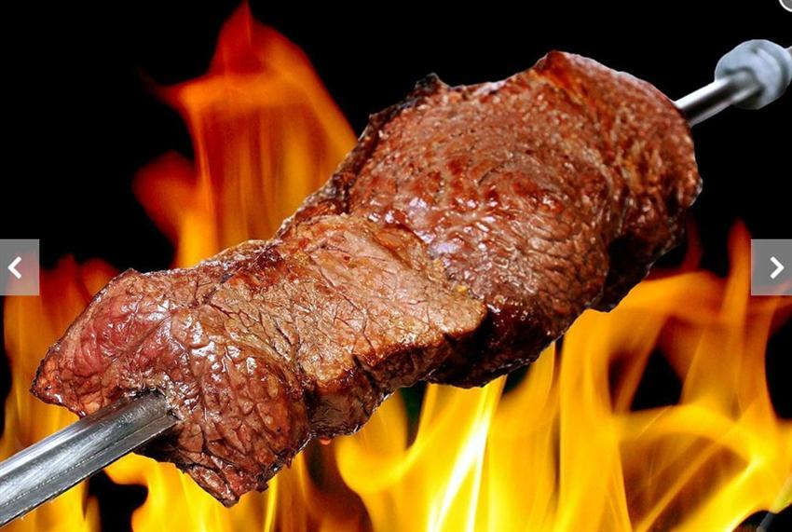
Food
In Brazil, churrasco is a Portuguese and Spanish term for a type of barbecue which originated in southern Brazil. It features different kinds of meat, pork, sausage and chicken which may be cooked over an open fire. The Brazilians have been barbecuing meat for a long time. Churrasco varies not only because of the variety of meat but also because of the sauces. One common way to serve churrasco in Brazil is ata buffet, with waiters carrying trays of meat around the room and patrons choosing which cuts they want.

Slide 27
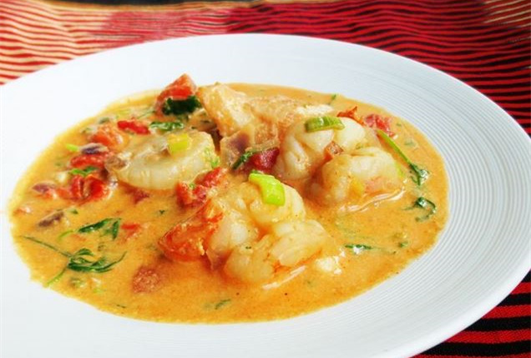
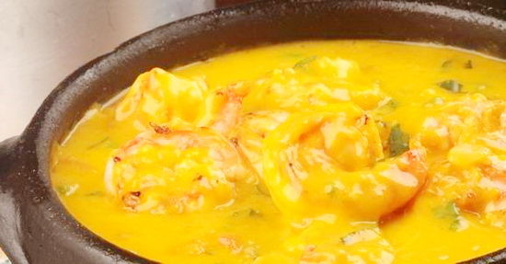
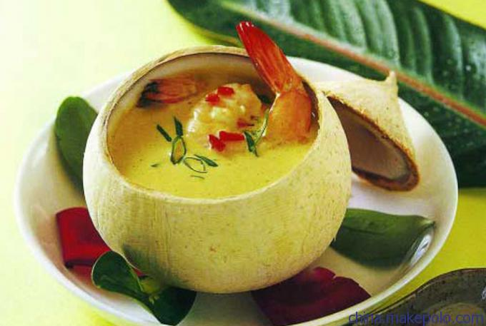
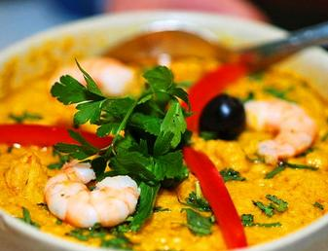
Food
One of the most popular dishes in Brazil is Camaroes Jangaderiro, a large plate of crispy breaded prawns stuffed with creamy Catupirycheese.

Slide 28
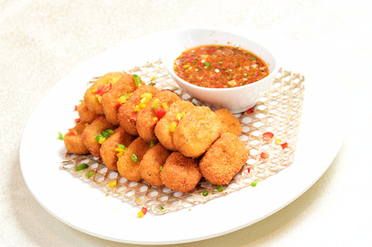
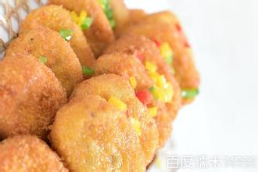
Food
Savory little snacks you can eat at any time of the day when you are not hungry enough for a complete meal. It comprises dozens ofcategories, such as empada, risoles, pastel, quibe, esfiha, croquete, bolinha de queijo, enrolado, folhado and pão de batata. It usually consists of dough wrapped around chopped meat, chicken, ham and/or cheese.

Slide 29


♥♥
Now, I want to say:
So,how about you???

Slide 30
谢谢聆听

